Slide 1

EVALUATING THE LAYOUT QUALITY OF UML CLASS DIAGRAMS USING MACHINE LEARNING
Gustav Bergström, Fadhl Hujainah, Truong Ho-Quang, Rodi Jolak, Satrio Adi Rukmono, Arif Nurwidyantoro, Michel R.V. Chaudron,
Evaluating the layout quality of UML class diagrams using machine learning,
Journal of Systems and Software, Volume 192,2022, 111413, ISSN 0164-1212,
https://doi.org/10.1016/j.jss.2022.111413.
(https://www.sciencedirect.com/science/article/pii/S016412122200125X)
Name: Fatima Masood
Roll No: MSSE71F23S006

Slide 2
Table of Contents
1- Introduction
2- Aims & Objectives
3- Contribution
4- Research Problem
5- Related Work
6- Prior work
7- Limitations
8- Data
9- Data Statistics
10- Features
11- Algorithms
12- Framework Diagram
13- Experimental Setup
14- Results
15- Discussions
16- Acknowledgements

Slide 3
INTRODUCTION
RESEARCH MAIN AREA: Evaluation of the quality of UML class diagrams using ML
RESEARCH SUB-AREA: Evaluating the layout quality of UML class diagrams
IMPORTANCE OF AREA:
Industry Setting
Educational Setting
Design Graph Layout Algorithms

Slide 4
AIMS AND OBJECTIVES
Create an automatic evaluator of the layout quality of the UML class
Finding good aspects of a diagram
Which aspects could be improved?

Slide 5
CONTRIBUTION
New automatic evaluator of the layout quality of UML class diagrams.
Most Strongly related features of UML class diagrams to the quality of layout.
Evaluate the performance of the layout evaluator.
Offer a dataset of labeled UML class diagrams.

Slide 6
RESEARCH PROBLEM
Main Problem:
How to make an Automatic layout quality evaluator of UML class diagrams using ML?
Sub Problems:
How well does the automatic evaluator of the layout quality of class diagrams perform?
Which features of class diagram layout are the most important for evaluating their layout quality

Slide 7
RELATED WORK
Automatic evaluation of the layout of (class) diagrams, no prior work is known.
Some works are related to different parts of this study:
Estimating layout quality
Finding the most important layout aesthetics.

Slide 8
PRIOR WORK
B. Karasneh and M. R. V. Chaudron, "Extracting UML models from images," 2013 5th International Conference on Computer Science and Information Technology, Amman, Jordan, 2013, pp. 169-178, doi: 10.1109/CSIT.2013.6588776. & B. Karasneh and M. R. V. Chaudron, "Img2UML: A System for Extracting UML Models from Images," 2013 39th Euromicro Conference on Software Engineering and Advanced Applications, Santander, Spain, 2013, pp. 134-137, doi: 10.1109/SEAA.2013.45.
image processing to find features of UML diagrams
reads an image of a UML diagram
extracts its semantic meaning
creates an XMI file of the UML model from this information.

Slide 9
PRIOR WORK
T. Ho-Quang, M. R. V. Chaudron, I. Samúelsson, J. Hjaltason, B. Karasneh and H. Osman, "Automatic Classification of UML Class Diagrams from Images," 2014 21st Asia-Pacific Software Engineering Conference, Jeju, Korea (South), 2014, pp. 399-406, doi: 10.1109/APSEC.2014.65.
Automatic classifier that recognize an image as a UML class diagram
It uses image processing to find features in images
ML to train a model that can distinguish if an image is a class diagram or not.

Slide 10
PRIOR WORK
Nikiforova, Oksana, et al. "Several issues on the layout of the UML sequence and class diagram." Proc. of the 9th Int. Conf. on Software Engineering Advances. 2014.
Create a list of layout principles
Analyze how different layout algorithms are used by some popular UML modeling.
Layouts of both class and sequence diagrams

Slide 11
LIMITATIONS
Uniformity
UML Conventions
Text
Highlighting/Coloring
Semantical aspects of the layout of diagrams :
Design Principles
Types of Class Diagrams

Slide 12
DATA
Lindholmen-dataset of images created by Hebig et al. (2016)
Data Year: (2016).
Total Data: 100,000 UML Diagrams
Assembled through mining open source repositories on GitHub for images.
The initial subset of 3000 diagrams was selected randomly.

Slide 13
DATA STATISTICS
Total : 100000 UML Diagrams.
Initial Subset: 3000 UML Diagrams.
654 diagrams after filtering.
Total of 609 diagrams in the final dataset.

Slide 14
FEATURES
Aspects of Quality of Layout
Set of Image Features

Slide 15
Aspects of Quality of Layout
A1 — line crossings
A2 — Line bends
A3 — Orthogonality.
A4 — Line lengths
A5 — Diagram drawing size
A6 — Symmetry.
A7 — Line angular distances
A8 — Class placement
A9 — Overlapping
A10 — Node sizes.

Slide 16
Set of Image Features
F1 — Line crossings.
F2 — Crossing angles
F3 — Line bends
F4 — Line angles.
F5 — Line orthogonality.
F6 — Rectangle orthogonality
F7 — Average line length
F8 — Line length variation
F9 — Longest line

Slide 17
Set of Image Features
F10 — Shortest line
F11 — Rectangle coverage
F12 — Aspect ratio
F13 — Rectangle distribution
F14 — Rectangle proximity
F15 — Rectangle size
F16 — Rectangle size variation.
F17 — Number of rectangles
F18 — Number of lines

Slide 18
ALGORITHMS
Support vector, rule-based, and tree-based 12 approaches:
Gaussian Processes (Mackay, 1998)
Linear Regression
Multi-layer Perceptron
Simple Linear Regression
Support Vector Regression (SMOreg) (Shevade et al., 1999; Smola and Schoelkopf, 1998)
Decision Table (Kohavi, 1995)

Slide 19
ALGORITHMS
Support vector, rule-based, and tree-based 12 approaches:
M5 Rules (Holmes et al., 1999; Quinlan, 1992; Wang and Witten, 1997)
Decision Stump
M5P (Quinlan, 1992; Wang and Witten, 1997)
Random Forest (Breiman, 2001)
Random Tree
REP Tree

Slide 20
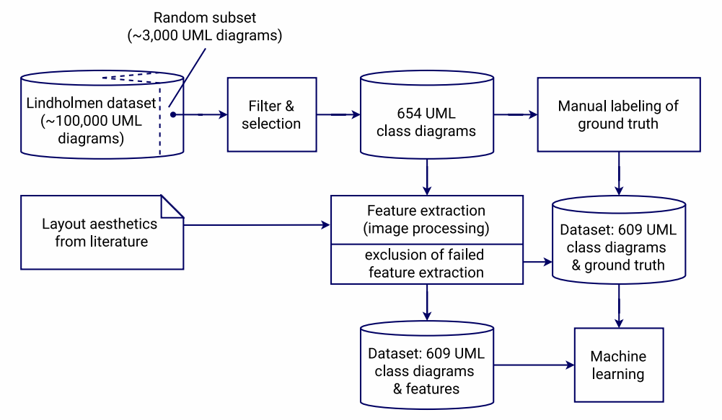
FRAMEWORK DIAGRAM

Slide 21
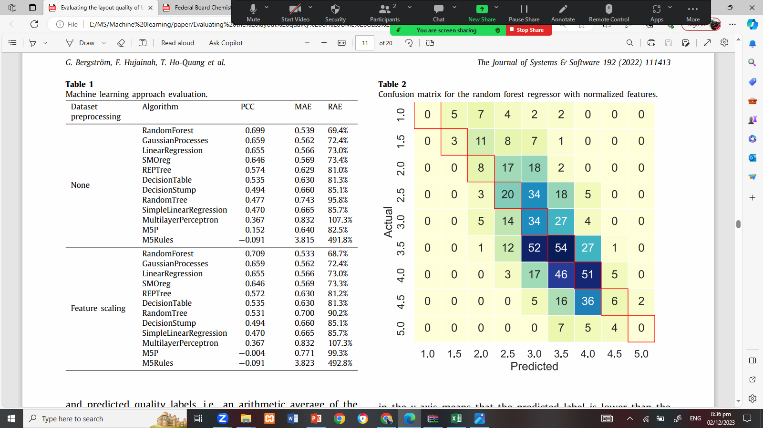
RESULTS
Three evaluation metrics:
Pearson’s correlation coefficient (PCC)
Mean Absolute Error (MAE)
Relative Absolute Error (RAE).
The best-performing approach is the Random Forest algorithm.

Slide 22
RESULTS
Results of our 10-fold validation using a confusion matrix.
The evaluations of 9 classes between 1-5

Slide 23
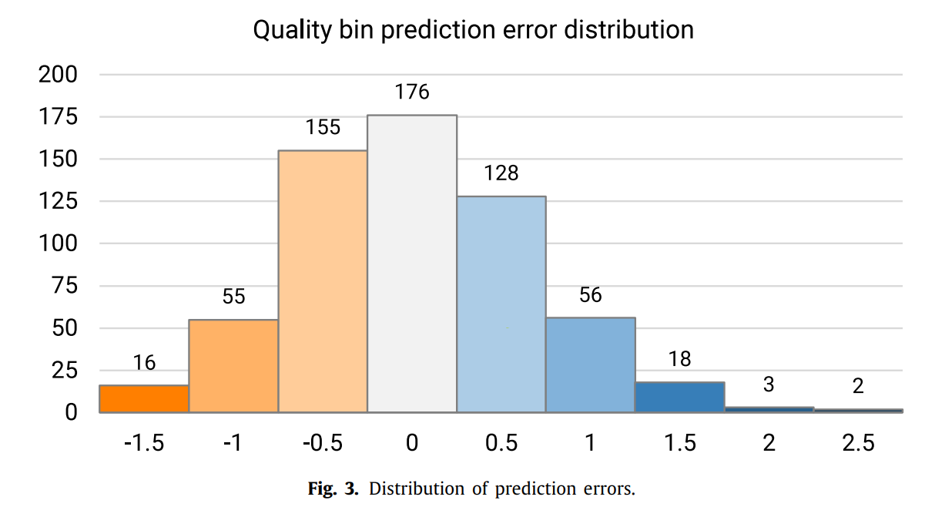
RESULTS
Prediction errors in a higher level.
Negative values in the y-axis means:
the predicted label is lower than the actual label

Slide 24
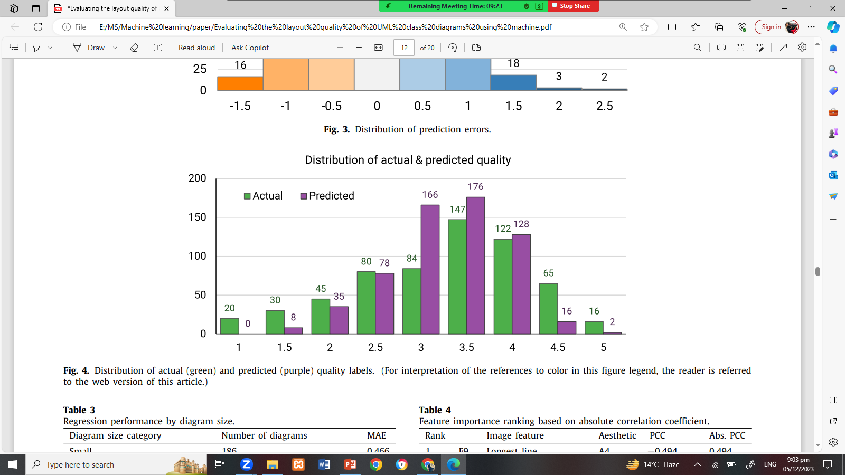
RESULTS
Distributions of the actual quality labels and the predicted quality labels.
x-axis: the value of the layout quality.
y-axis denotes: number of images classified into that ‘bucket’

Slide 25
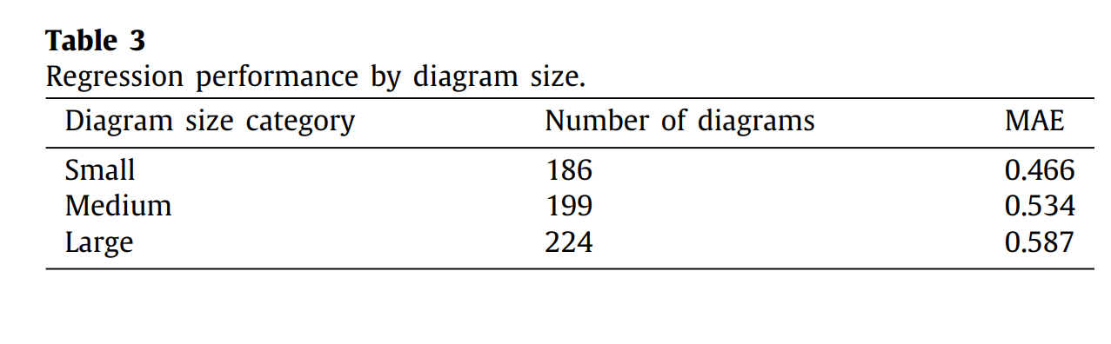
RESULTS
Mean absolute error values for the categories.
Better Performance with smaller diagrams

Slide 26
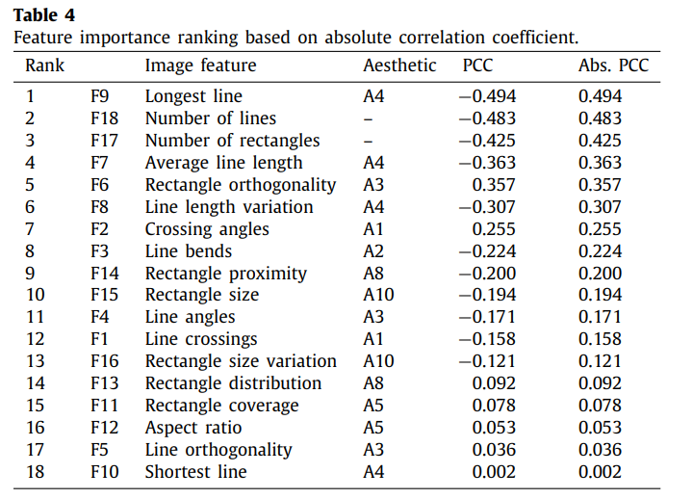
RESULTS
Closer to 1: with more significant contribution.
Sign: positive or negative contribution
Important: (A4), F9, F7, and F8.
Essential: rectangle orthogonality (F6)
The third category of important features: the shape, positioning, and orientation of lines between classes (features F2 Crossing Lines and F3 Line Bends)
not very significant: F10 Shortest Line and F5 Line Orthogonality.

Slide 27
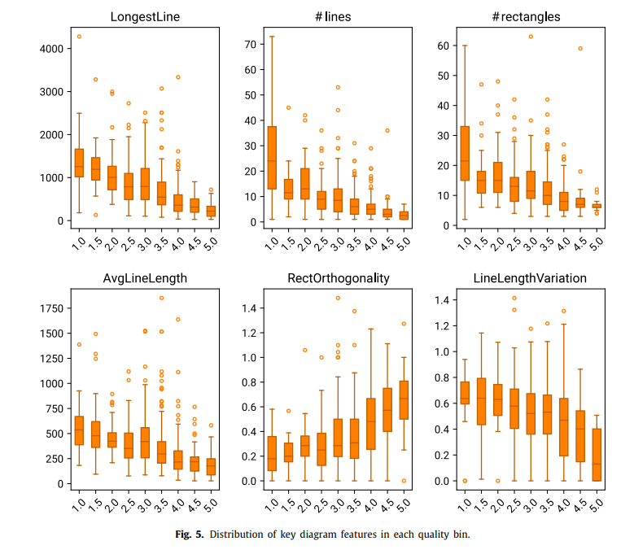
RESULTS
Higher-quality diagrams:
have shorter lines.
less varied line lengths.
smaller number of diagram elements
more orthogonal rectangles positioning.
Variance for higher quality bins tend to be smaller than those in lower quality bins

Slide 28
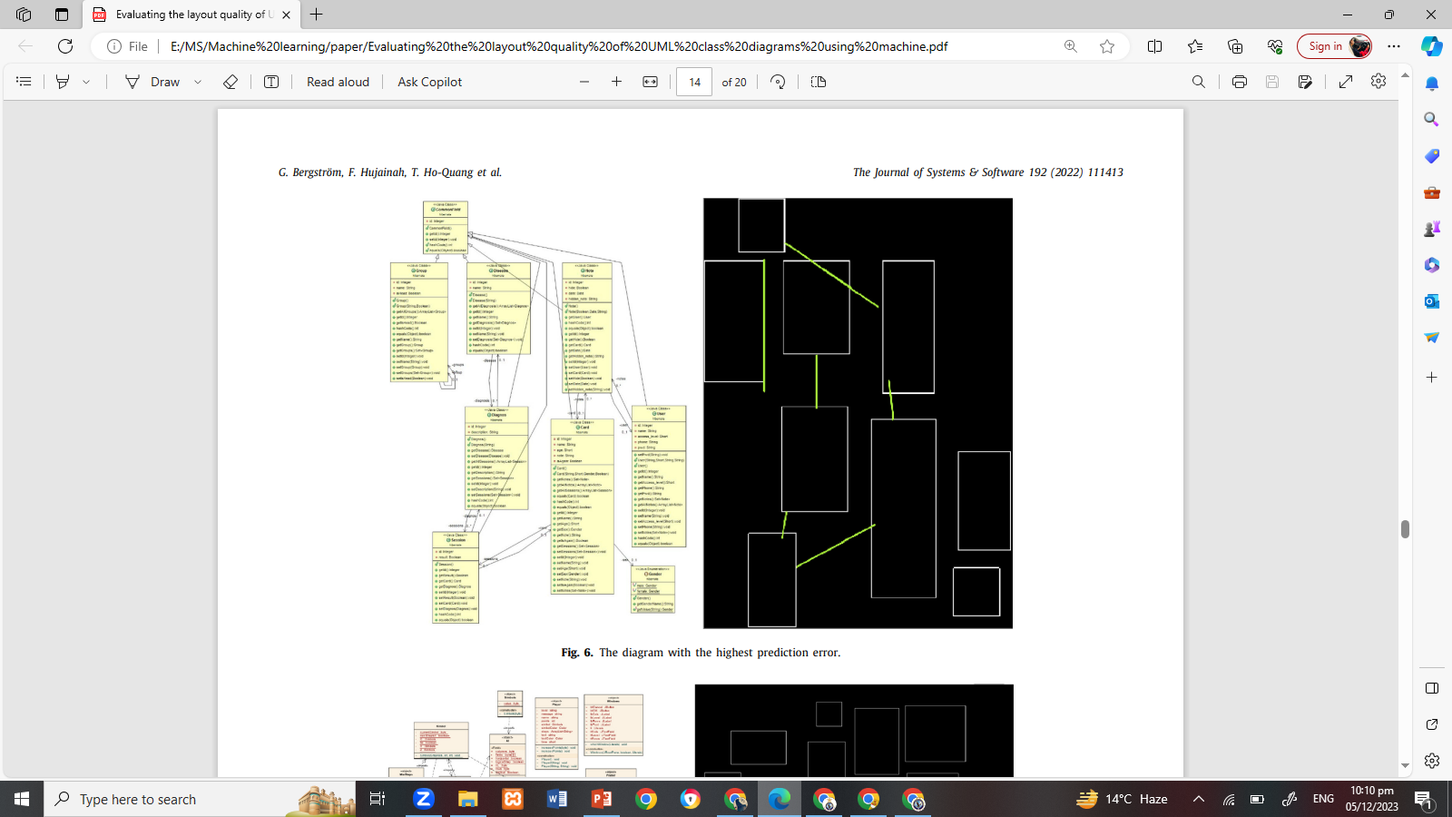
DISCUSSIONS
Image processing

Slide 29
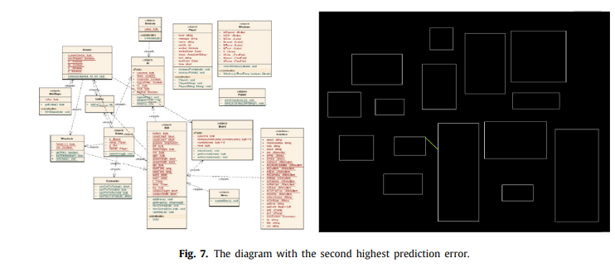
DISCUSSIONS
The estimator performance
Image processing

Slide 30
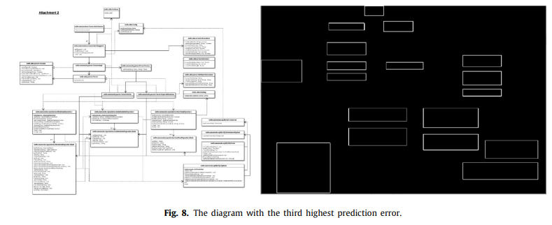
DISCUSSIONS
Image processing

Slide 31
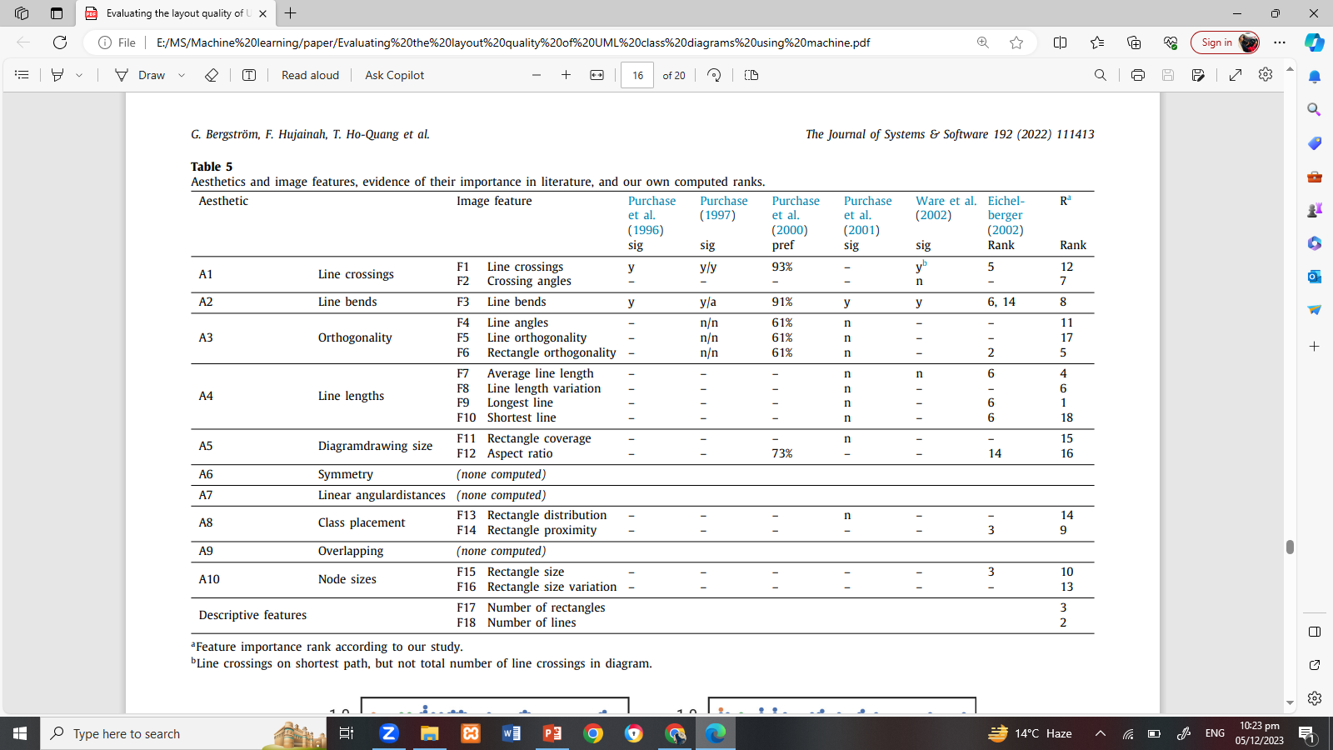
DISCUSSIONS
Essential aesthetics

Slide 32
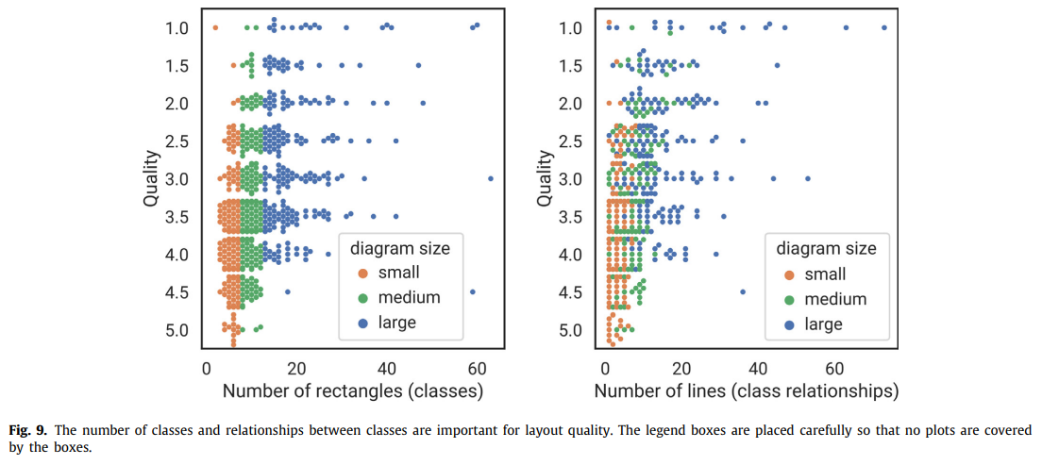
DISCUSSIONS
Essential aesthetics
High importance: line lengths (A4), descriptive features, and orthogonality (A3)

Slide 33
DISCUSSIONS
Essential aesthetics
Somewhat important: line crossings (A1), line bends (A2), class placement (A8), and node sizes (a10)
Insignificant: diagram drawing size (A5)
neither rectangle coverage (F11) nor diagram aspect ratio (F12) affect perceived layout quality.
No previous work related to the importance of rectangle coverage was found

Slide 34
ACKNOWLEDGEMENTS

Slide 35
THANK YOU

